Slide 1

Copyright © 2012 Addison-Wesley. All rights reserved.

Slide 2
Lecture 10
CS4080
Exception Handling (Chapter 14)

Slide 3
Outline
Introduction to Exception Handling
Exception Handling in C++
Exception Handling in Java
Exception Handling in Python
In-class discussion

Slide 4
Introduction to Exception Handling
In a language without exception handling
When an exception occurs, control goes to the operating system, where a message is displayed and the program is terminated
In a language with exception handling
Programs are allowed to trap some exceptions, thereby providing the possibility of fixing the problem and continuing

Slide 5
Basic Concepts
Many languages allow programs to trap input/output errors (including EOF)
An exception is any unusual event, either erroneous or not, detectable by either hardware or software, that may require special processing
The special processing that may be required after detection of an exception is called exception handling
The exception handling code unit is called an exception handler

Slide 6
Exception Handling Alternatives
An exception is raised when its associated event occurs
A language that does not have exception handling capabilities can still define, detect, raise, and handle exceptions (user defined, software detected)
Alternatives:
Send an auxiliary parameter or use the return value to indicate the return status of a subprogram
Pass a label parameter to all subprograms (error return is to the passed label)
Pass an exception handling subprogram to all subprograms

Slide 7
Advantages of Built-in Exception Handling
Error detection code is tedious to write and it clutters the program
Exception handling encourages programmers to consider many different possible errors
Exception propagation allows a high level of reuse of exception handling code

Slide 8
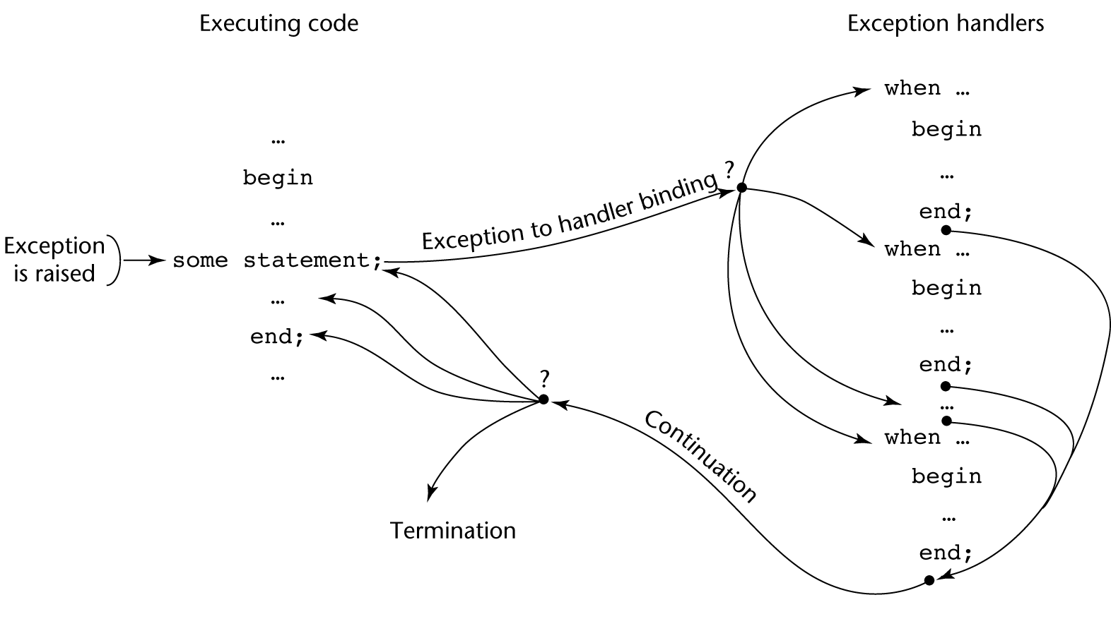
Exception Handling Control Flow

Slide 9
Exception Handling in C++
Added to C++ in 1990
Design is based on that of CLU, Ada, and ML

Slide 10
C++ Exception Handlers
Exception Handlers Form:
try {
-- code that is expected to raise an exception
}
catch (formal parameter) {
-- handler code
}
...
catch (formal parameter) {
-- handler code
}

Slide 11
Throwing Exceptions
Exceptions are all raised explicitly by the statement:
throw [expression];
The brackets are metasymbols
A throw without an operand can only appear in a handler; when it appears, it simply re-raises the exception, which is then handled elsewhere
The type of the expression disambiguates the intended handler

Slide 12
Unhandled Exceptions
An unhandled exception is propagated to the caller of the function in which it is raised
This propagation continues to the main function
If no handler is found, the default handler is called

Slide 13
C++: Example
double div (double num, double denom) {
if (denom == 0) throw “Error: cannot divide by 0\n”;
else if (denom < 0) throw denom;
else return num/denom;
}
int main () { …
try { quot =- div (d1, d2); … }
catch (string e) { …}
catch (double v) { …}
cout << “end of program\n”;
return 0;
}

Slide 14
C++: Exception handling with classes
class NegativeSize { }; //define a new exception type
class rectangle { … void setLength(double); …}
void rectangle::setLength(double len) {
if (len <0) throw NegativeSize(); else … }
int main () { …
try {
myRect.setLength(l); …
}
catch (NegativeSize e) {….}
…
return 0;
}

Slide 15
Exception Handling in Java
Based on that of C++, but more in line with OOP philosophy
All exceptions are objects of classes that are descendants of the Throwable class

Slide 16
Java exception handling construct
try {
…
}
catch(…) { …}
…
catch(…) { …}
finally { …}

Slide 17
Classes of Exceptions
The Java library includes two subclasses of Throwable :
Error
Thrown by the Java interpreter for events such as heap overflow
Never handled by user programs
Exception
User-defined exceptions are usually subclasses of this
Has two predefined subclasses, IOException and RuntimeException (e.g., ArrayIndexOutOfBoundsException and NullPointerException

Slide 18
User-defined exception: an example
class NegInputException extends Exception
{ … }

Slide 19
Checked and Unchecked Exceptions
The Java throws clause is quite different from the throw clause of C++
Exceptions of class Error and RunTimeException and all of their descendants are called unchecked exceptions; all other exceptions are called checked exceptions
Checked exceptions that may be thrown by a method must be either:
Listed in the throws clause, or
Handled in the method

Slide 20
Java Example1
A very first Java program
public class FileWriteDemo {
public static void main (… ) throws IOException {
…
Scanner kb = new Scanner (System.in);
next = kb.nextInt();
…
}
}
//here must use throws IOException in main method’s prototype because IOException is a checked exception and it’s not handled in the main method

Slide 21
Example: throwing and catching exceptions
void buildList () throws IOException {
try {
…
if (newGrade < 0) throw NegInputException();
…
index = newGrade /10;
try {
freq[index]++;
}
catch (ArrayIndexOutofBound e) {
if (newGrade == 100) freq[9]++;
else …
} //end catch
} //end outside try
catch (NegInputException e) { … }
}

Slide 22
Summary
C++ includes no predefined exceptions Exceptions are bound to handlers by connecting the type of expression in the throw statement to that of the formal parameter of the catch function
Java exceptions are similar to C++ exceptions except that a Java exception must be a descendant of the Throwable class. Additionally Java includes a finally clause

